Slide 1
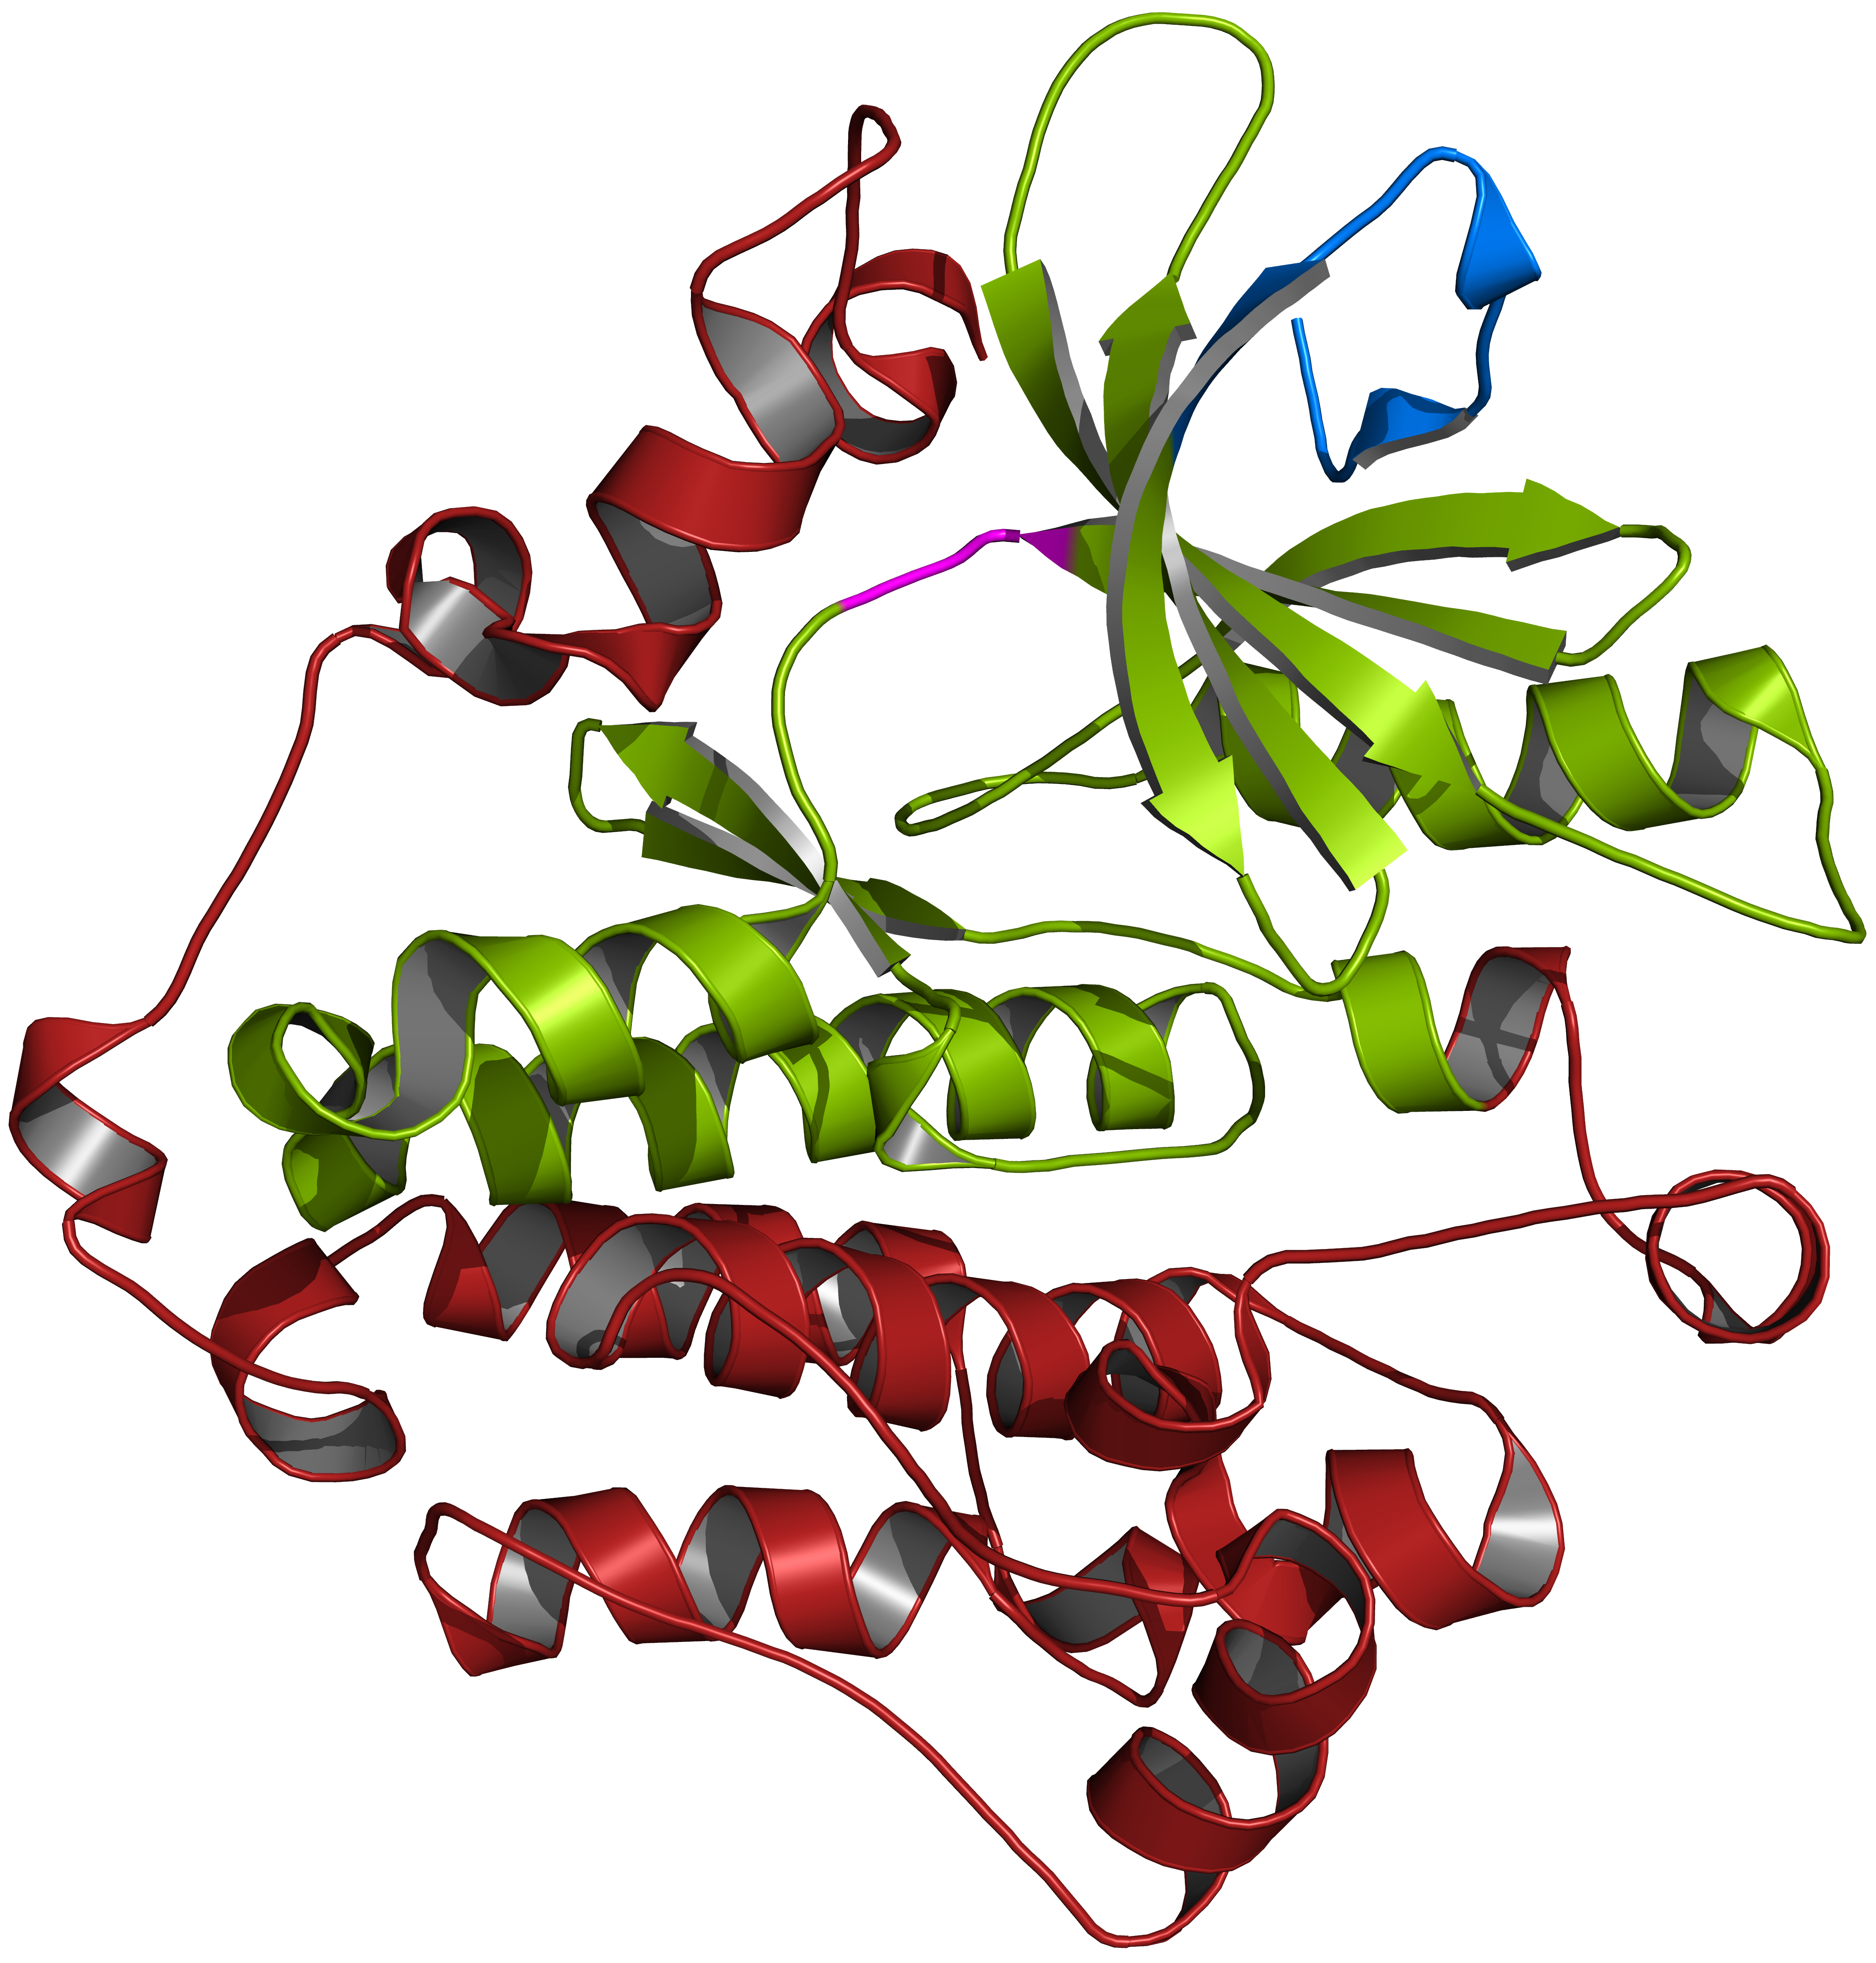
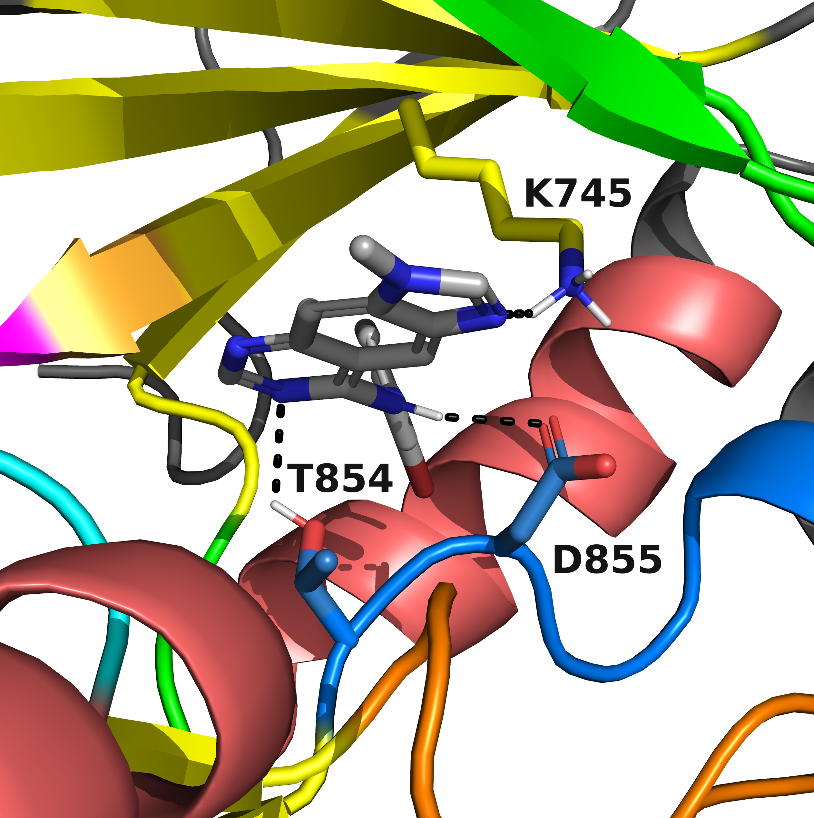
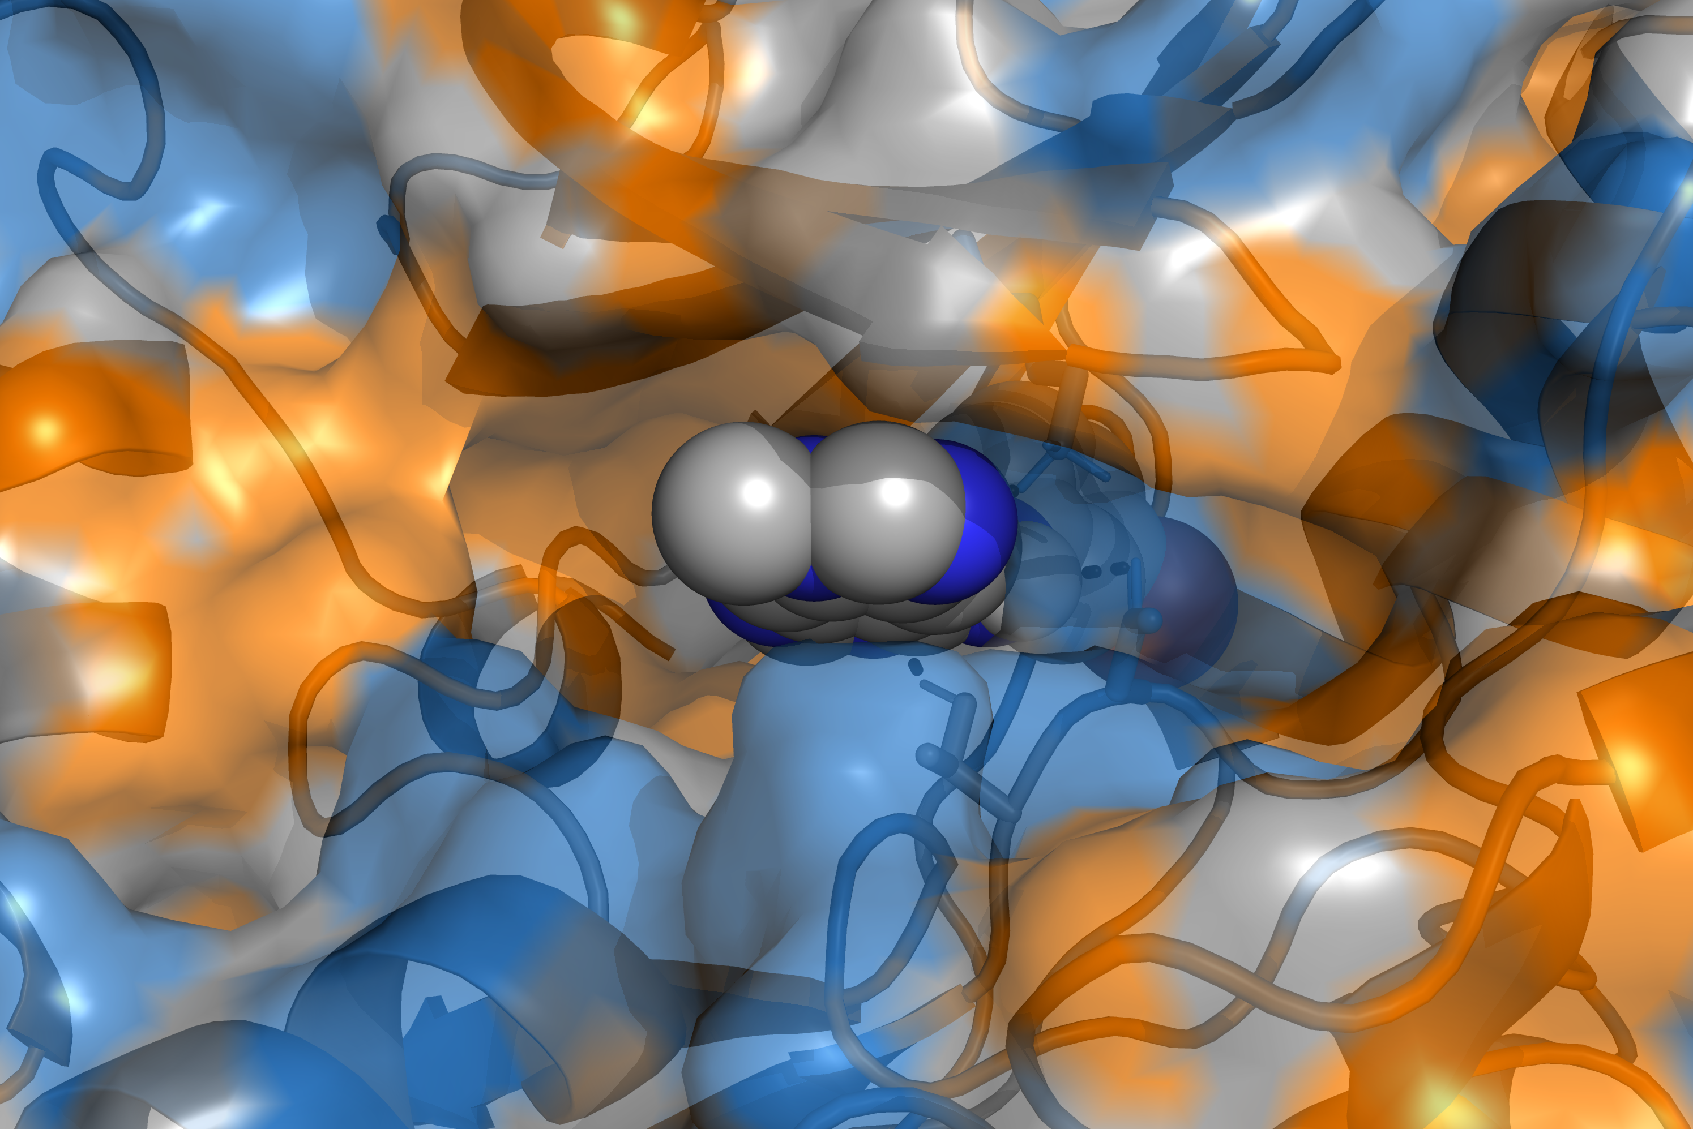
Protein Structure
Binding-Site Detection
Molecular Docking
Protein–Ligand Interaction Analysis
Visualization
Input
Binding Pocket
+
Output
Optimized Lead
Input
… | 0 | 1 | 0 | 1 | 0 | 0 | 0 | 1 | …
Similar Ligands
Similarity Search
Lead Compound
… | 1 | 1 | 0 | 0 | 0 | 1 | 0 | 0 | …
… | 0 | 0 | 0 | 1 | 0 | 0 | 0 | 0 | …
… | 0 | 0 | 1 | 0 | 1 | 0 | 1 | 1 | …

Slide 2
… | 0 | 1 | 0 | 1 | 0 | 0 | 0 | 1 | …
Similarity Assessment
… | 1 | 0 | 1 | 1 | 0 | 1 | 0 | 1 | …

